Slide 1




Axon Classic Cars
SQL Case Study
Author: Abhishek Kumar Shaw

Slide 2

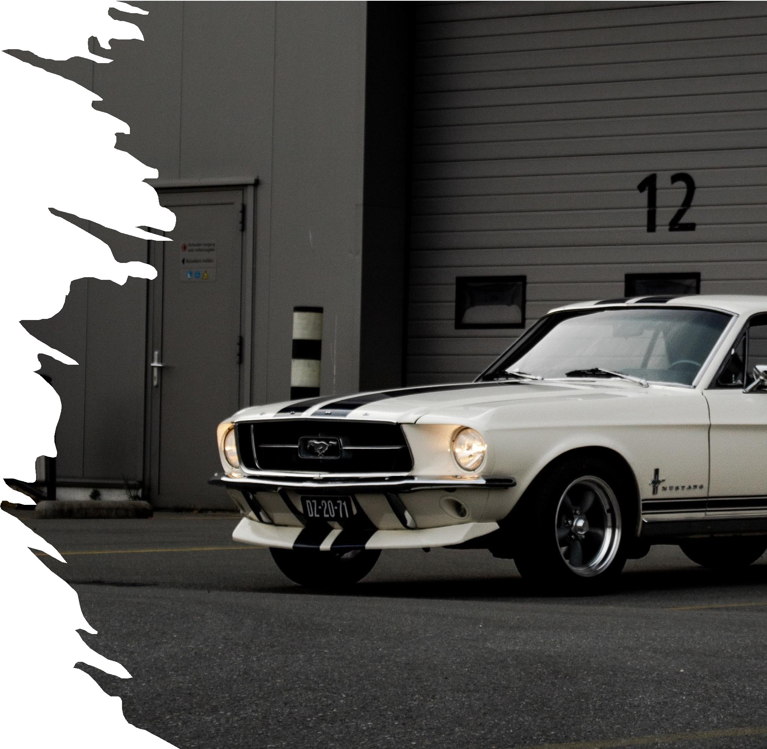
Table Of Contents
Introduction
Problem Statement
Dataset
Entity Relationship Diagram
Insight’s
Recommendation

Slide 3

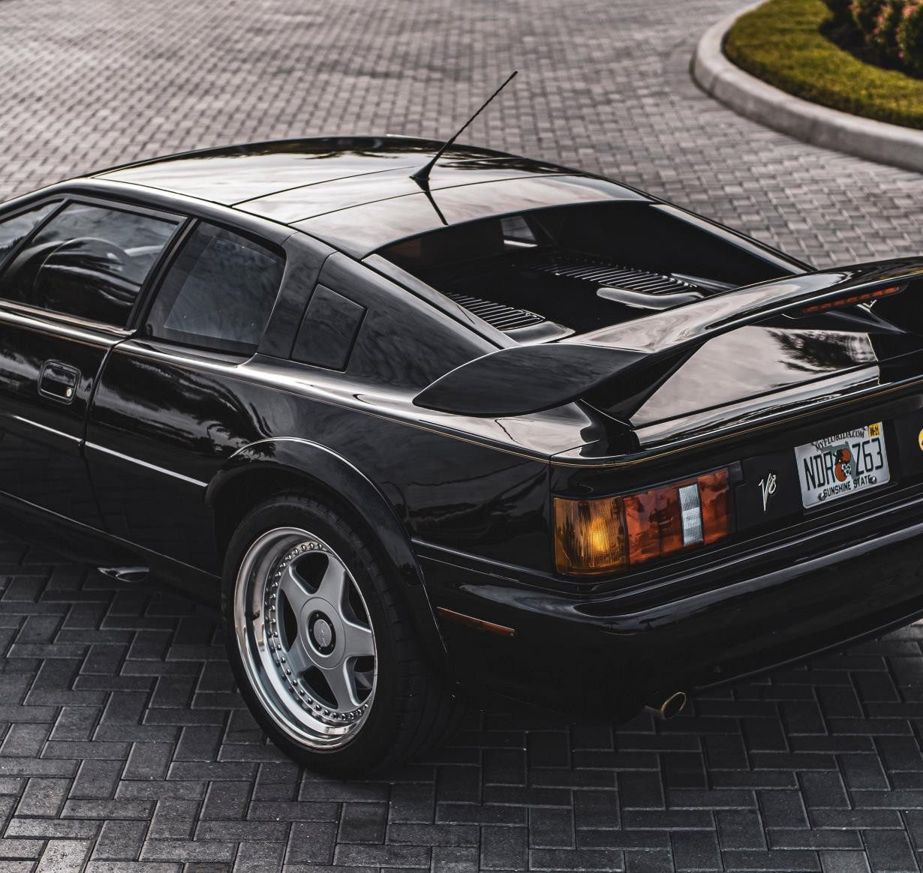
Introduction
Axon Classic Cars is the go-to place for classic car enthusiasts. They specialize in sourcing, restoring, and selling iconic vehicles from automotive history, always ensuring top quality, authenticity, and customer satisfaction.
Axon needs our assistance to analyze their data for future growth.

Slide 4
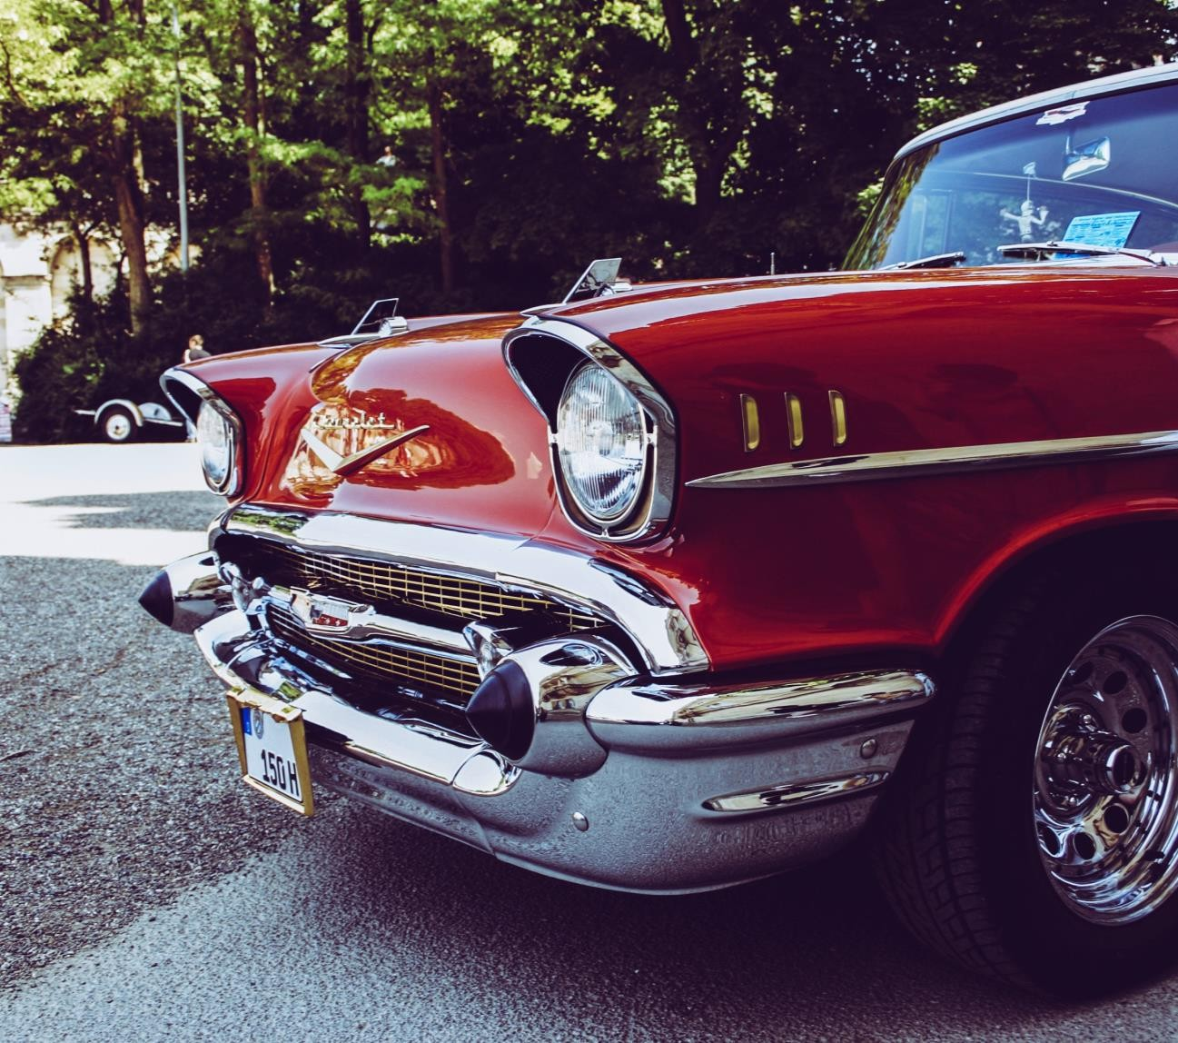
Problem Statement
Axon Classic Cars, a small retailer specializing in classic vehicles, struggles with sales data management and analysis.
Their sales team lacks access to a centralized system, impeding data comprehension.
Management faces difficulties in obtaining accurate, up-to-date sales reports, affecting decision-making.
To resolve these issues, Axon intends to implement a Business Intelligence (BI) solution, considering PowerBI and SQL, to enhance sales data management and analysis.

Slide 5
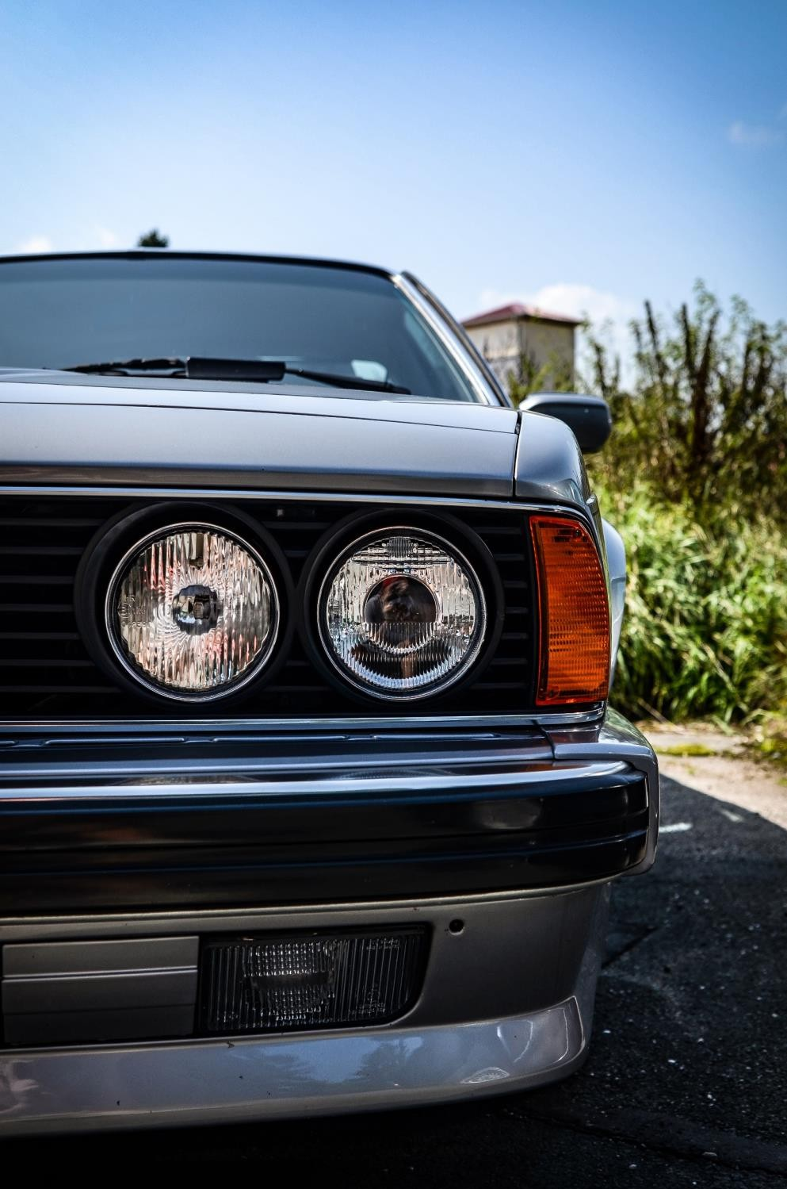
Dataset
The dataset for this project is provided through a MySQL database, which comprises several key tables
Customers: Contains customer data, which is crucial for understanding the client base and preferences.
Products: Lists scale model cars available for sale.
ProductLines: Categorizes products into various product line categories, aiding in sales analysis.
Orders: Records sales orders placed by customers, offering insights into
purchase trends.
OrderDetails: Contains detailed information about sales order line items, which is essential for a granular analysis of sales data.
Payments: Stores payment data, enabling tracking of customer
transactions.
Employees: Contains information about all employees and the organization's structure, including reporting relationships.
Offices: Provides data on sales office locations, which may impact sales performance.

Slide 6

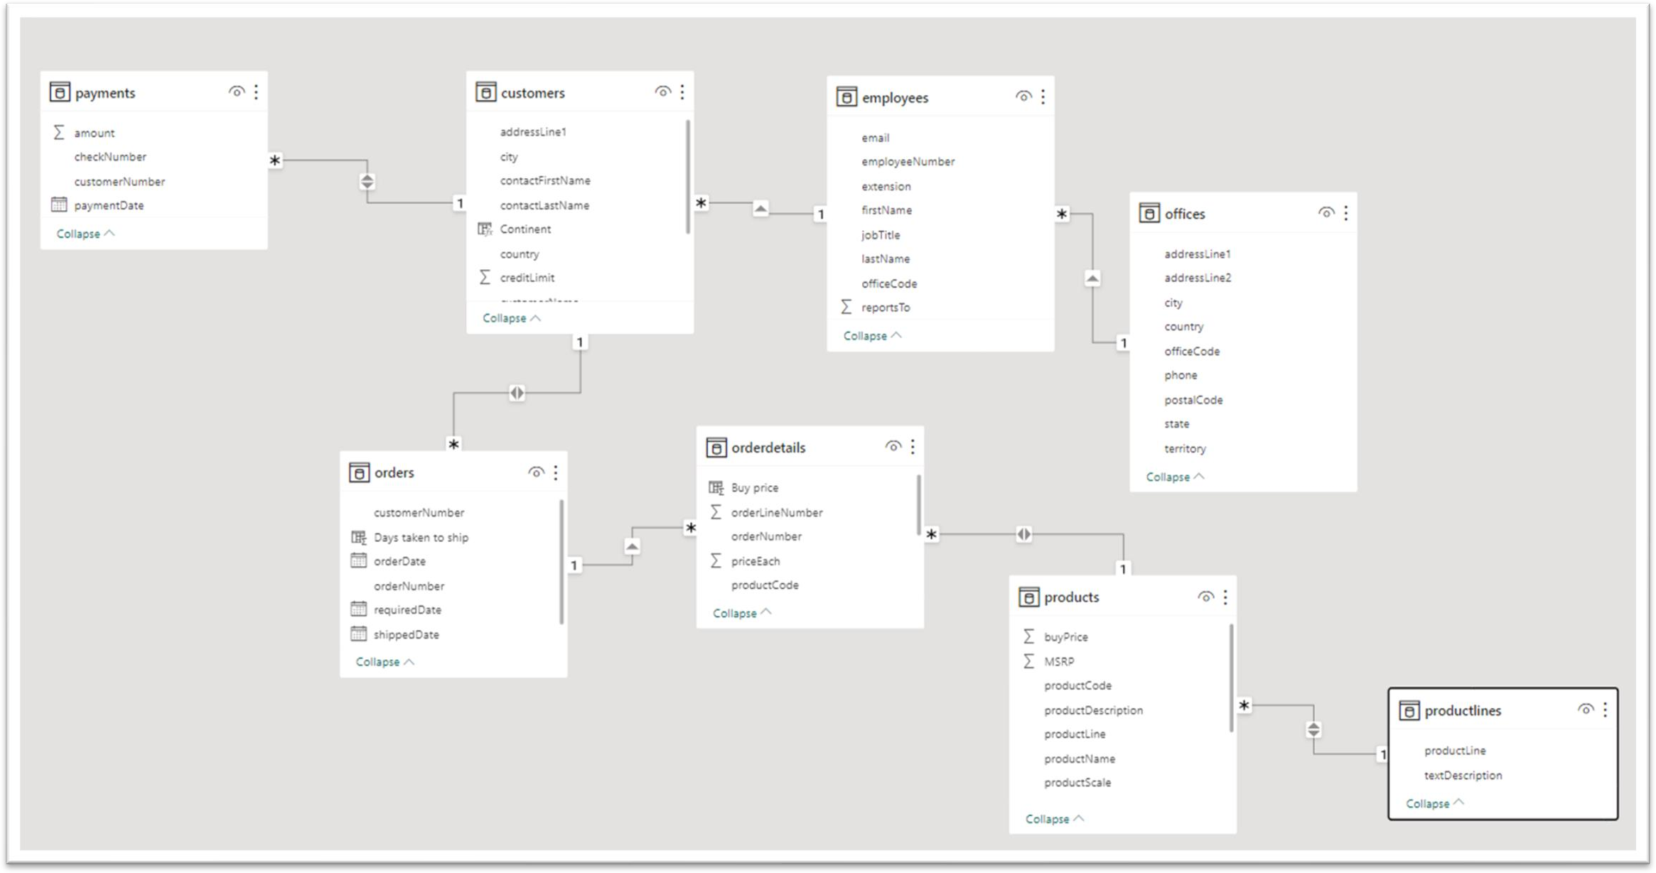
Entity Relationship Diagram

Slide 7


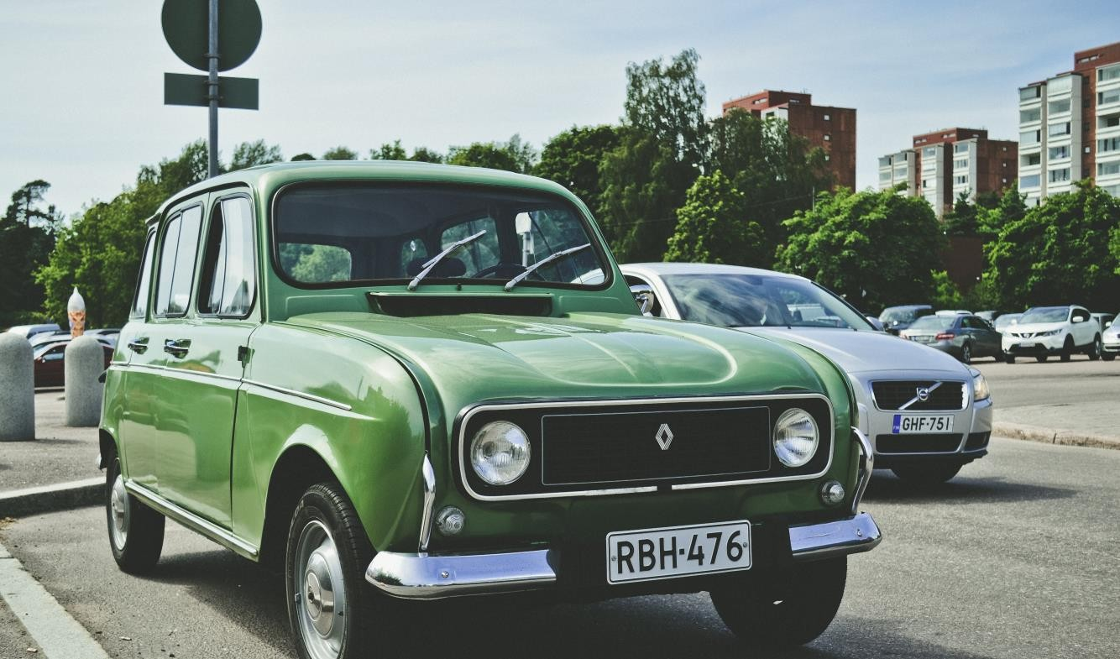
Uncovering Insights
RDBMS Used :- MySQL

Slide 8

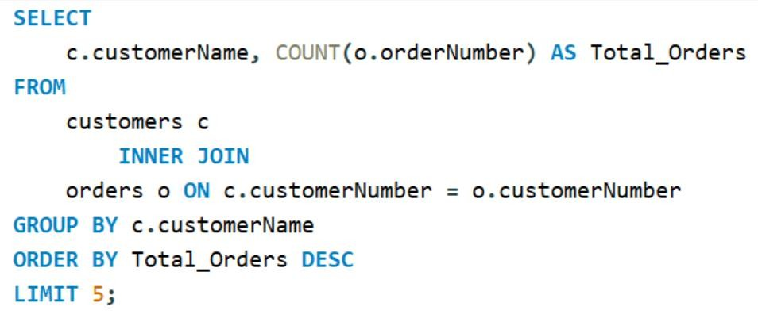
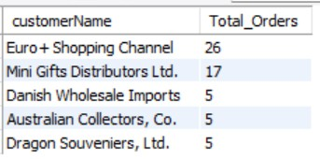
Who are the top 5 customers with the highest number of products ordered
Suggestion-
Build stronger relationships with 'Euro+ Shopping Channel' and 'Mini Gifts Distributors Ltd.' for better sales and potential collaborations

Slide 9

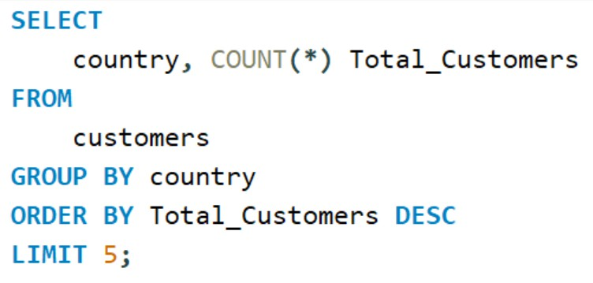
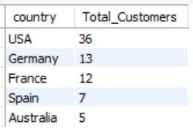
find the highest number of customers from which country
Suggestion -
Focus on strengthening the market in the USA, consider expansion in Germany and France, and implement targeted marketing in smaller markets like Spain and the Australia

Slide 10

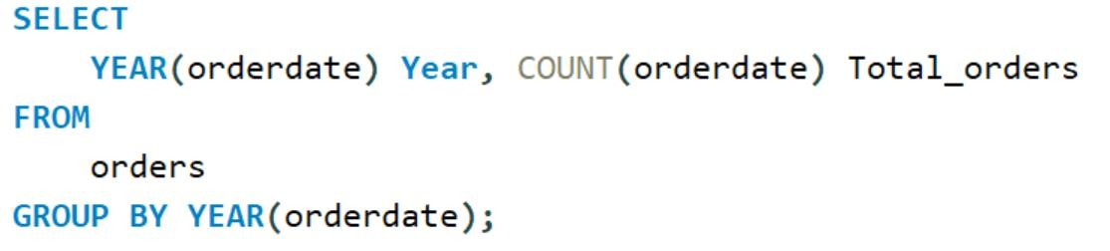
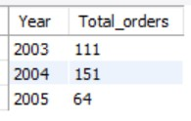
find each year how many orders are placed
Suggestion –
Sustain the positive momentum in the upcoming quarters of 2005 by placing a stronger focus on replicating the successful strategies from 2004 at Axon

Slide 11
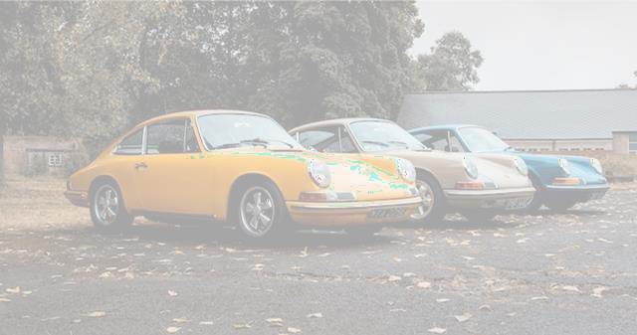
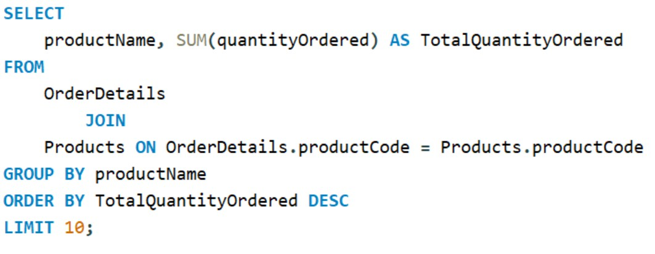
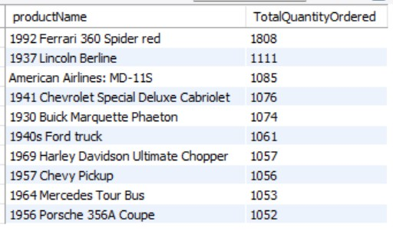
Which Are The Top 10 Most Ordered Products Based On The Total Quantity Ordered?
Suggestion –
Promote best-sellers like '1992 Ferrari 360 Spider red' and '1937 Lincoln Berline' due to high demand.

Slide 12

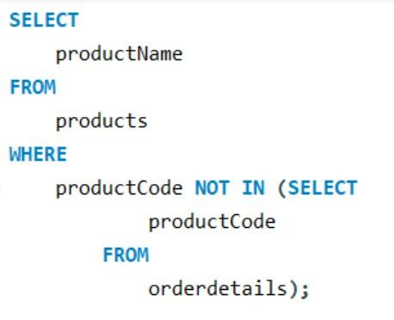
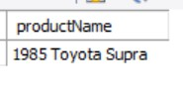
find the product which is not ordered by any customer
Suggestion –
Since the Manufacturer’s Suggested Retail Price average price is $100.43, think about lowering the MSRP or offering a special deal for the '1985 Toyota Supra,' which is currently priced at $107.57

Slide 13

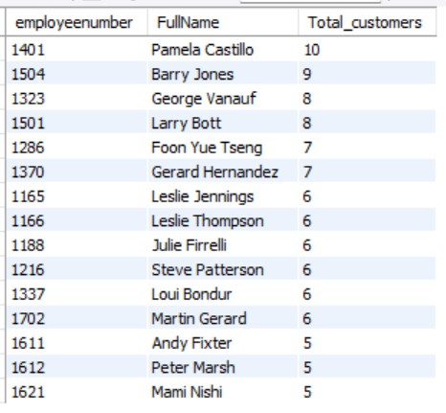
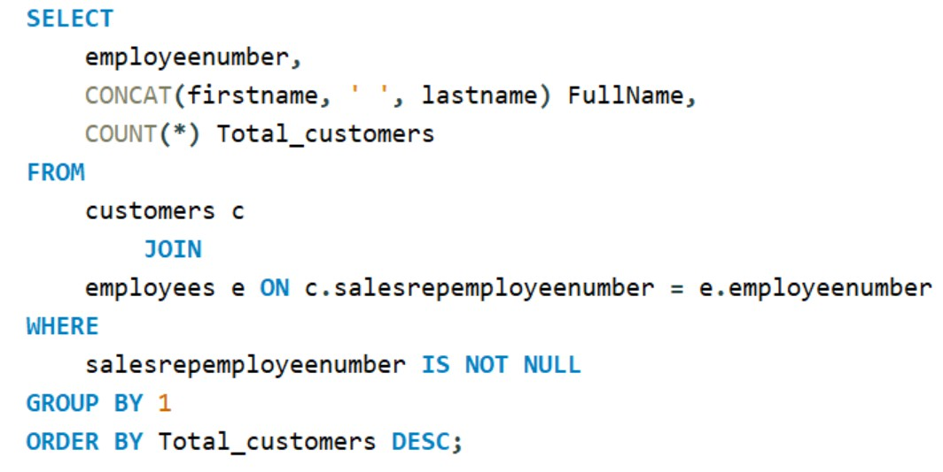
Find The Number Of Customers For Each Sales Representative
Suggestion –
Acknowledge and reward high-performing employees like Pamela Castillo and Barry Jones for their substantial customer base. Encourage other employees to enhance customer engagement.

Slide 14

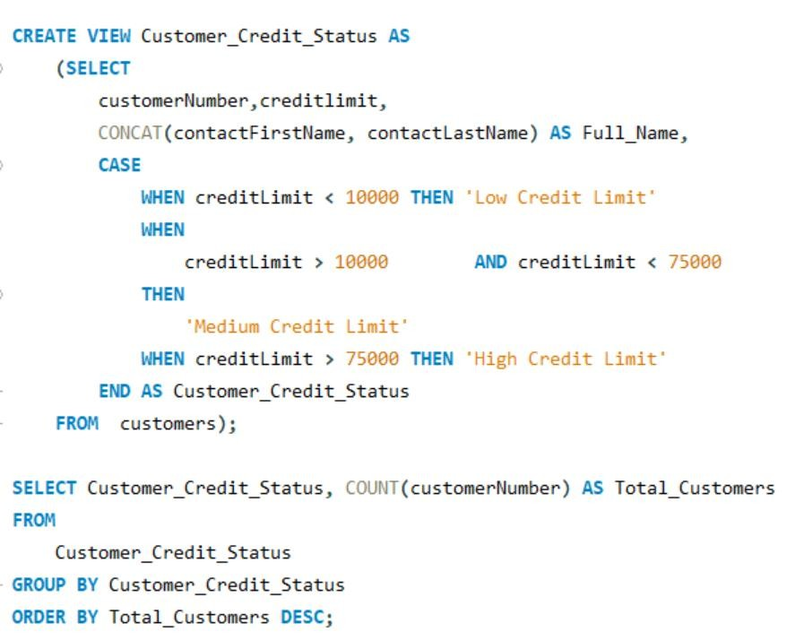
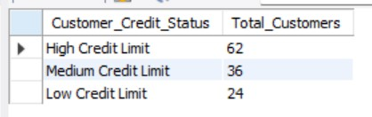
Show customers grouped by credit limit status, divided into three categories. and show the count of customers in each group
Suggestion-
Grow and retain the 'High Credit Limit' customer base, while developing strategies to engage more with 'Medium' and 'Low Credit Limit' customers for increased sales.

Slide 15

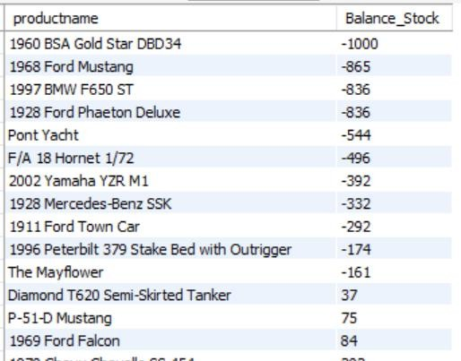
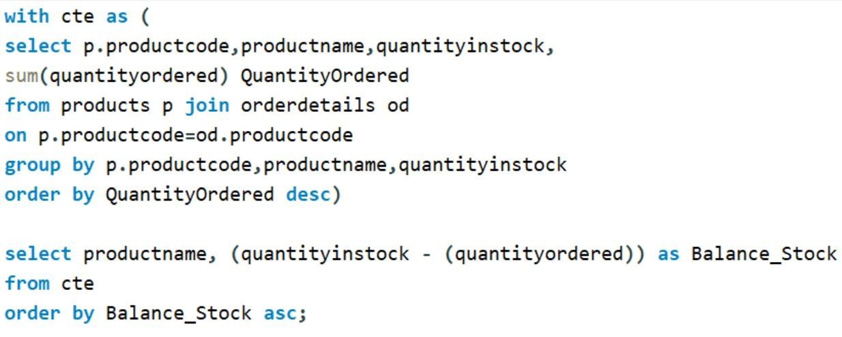
find product-wise how much stock remained in the classic model's warehouse
Suggestion-
Fix low stock levels for these products to prevent shortages. Make sure there are enough of these items to keep customers happy and satisfied.

Slide 16

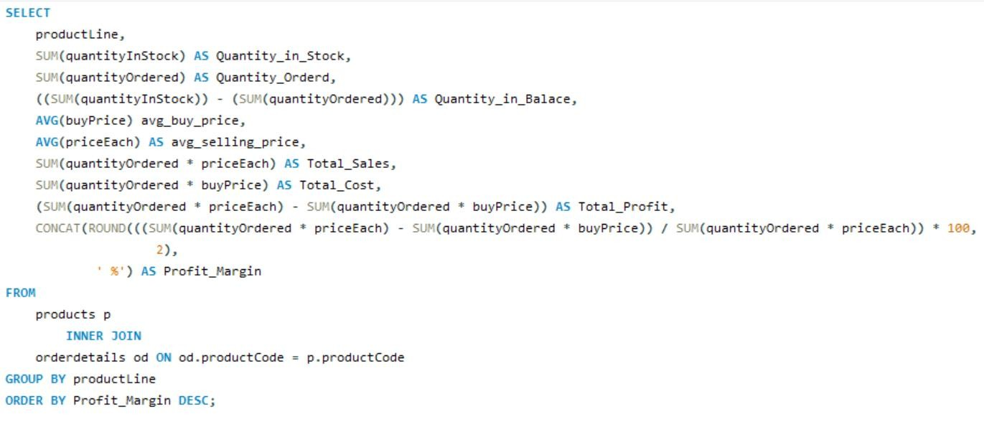
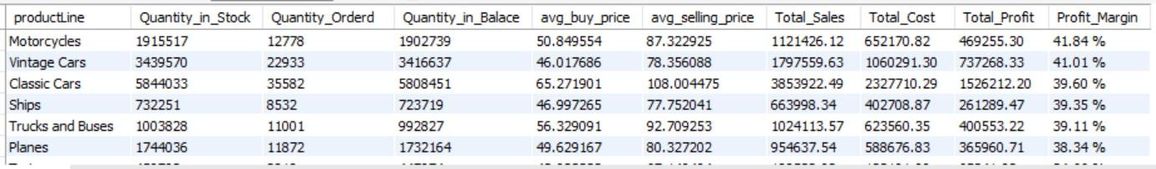
find the profit margin for each Product Line
Suggestion-
Concentrate on selling more 'Motorcycles' and 'Vintage Cars' as they have high profits and plenty in stock. Work on boosting 'Trains' sales by increasing profits and stock.

Slide 17
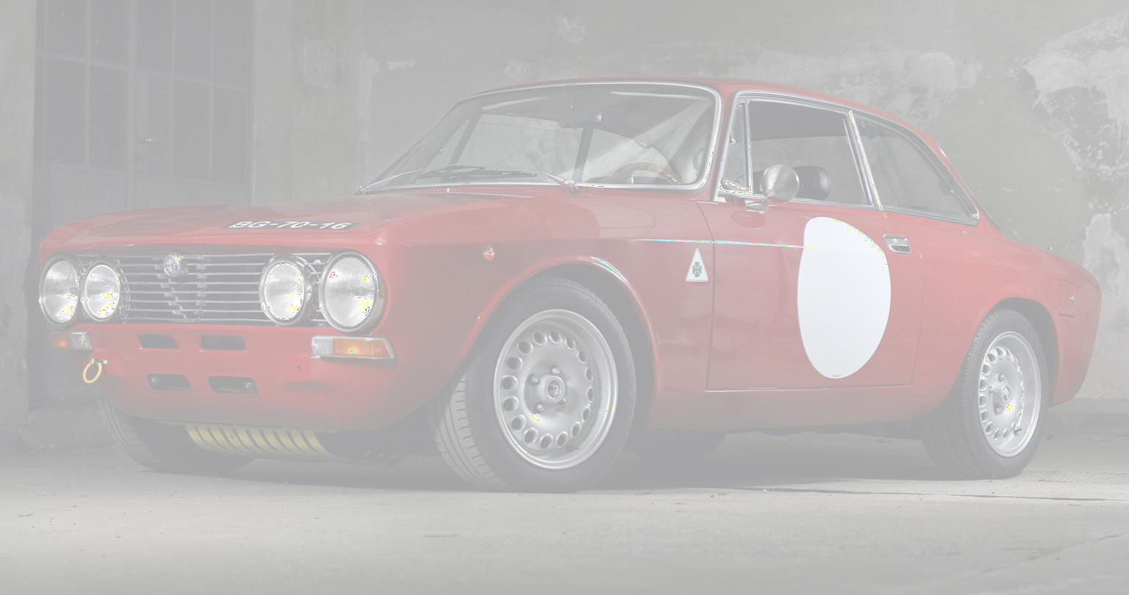
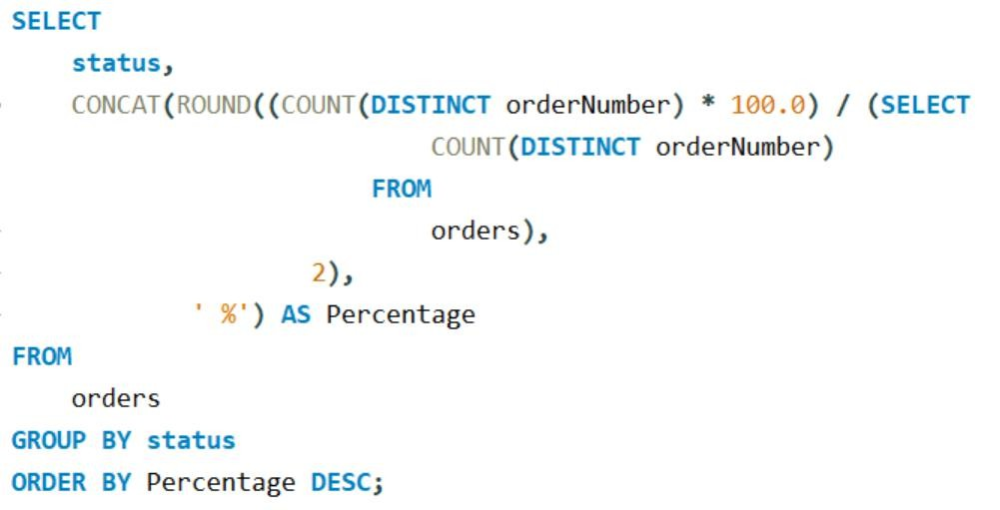
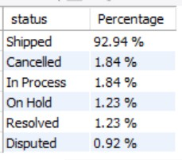
Provide the percentage of orders categorized by their delivery
status.
Suggestion-
Maintain efficient shipping and address issues with cancelled and pending orders to enhance customer satisfaction

Slide 18

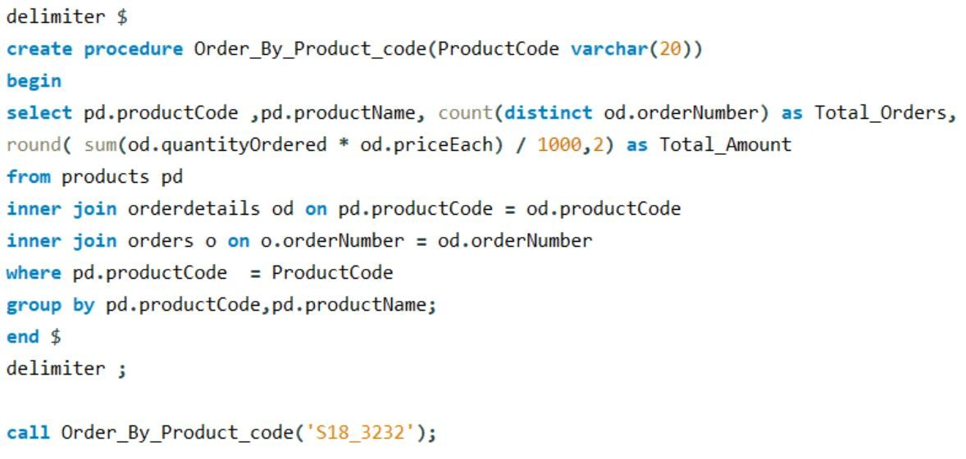
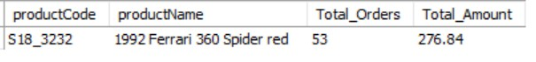
Give Me The Store Procedure That Takes The Product - Code As Input And Gives The Total Orders And Total Amount
Suggestion-
Implement a product code lookup feature, allowing Axon to retrieve detailed product information by entering the product code.

Slide 19

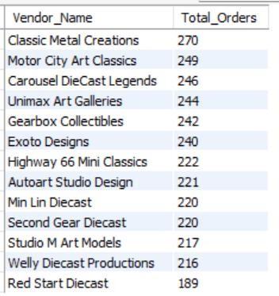
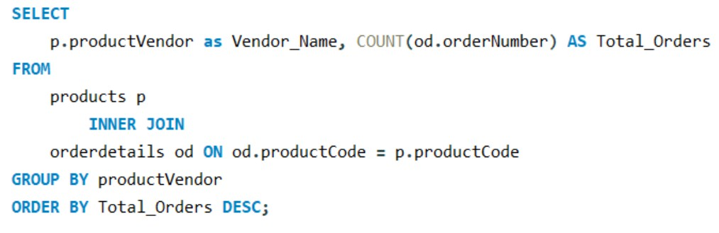
Find Number Of Products Ordered By Each Vendor
Suggestion-
Enhance collaborations with top-performing vendors like 'Classic Metal Creations,' 'Motor City Art Classics' and 'Carousel DieCast Legends' to boost sales.

Slide 20


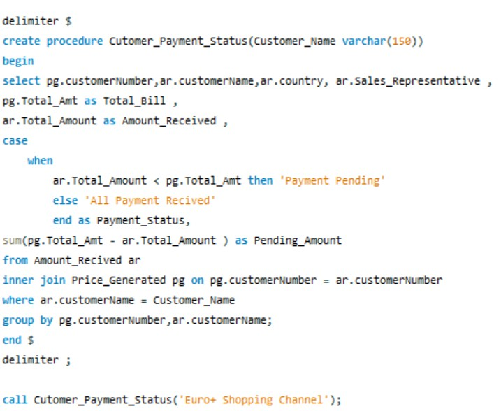
Create a stored procedure that takes a customer's name as input and returns the following information:
Customer Name
Sales Representative Number
Total Bill
Amount Paid by the
Customer
Payment Status (Amount Paid or Pending)
Pending Amount
The procedure should provide details about the customer's financial transactions,
including their payment
status and pending amount.

Slide 21
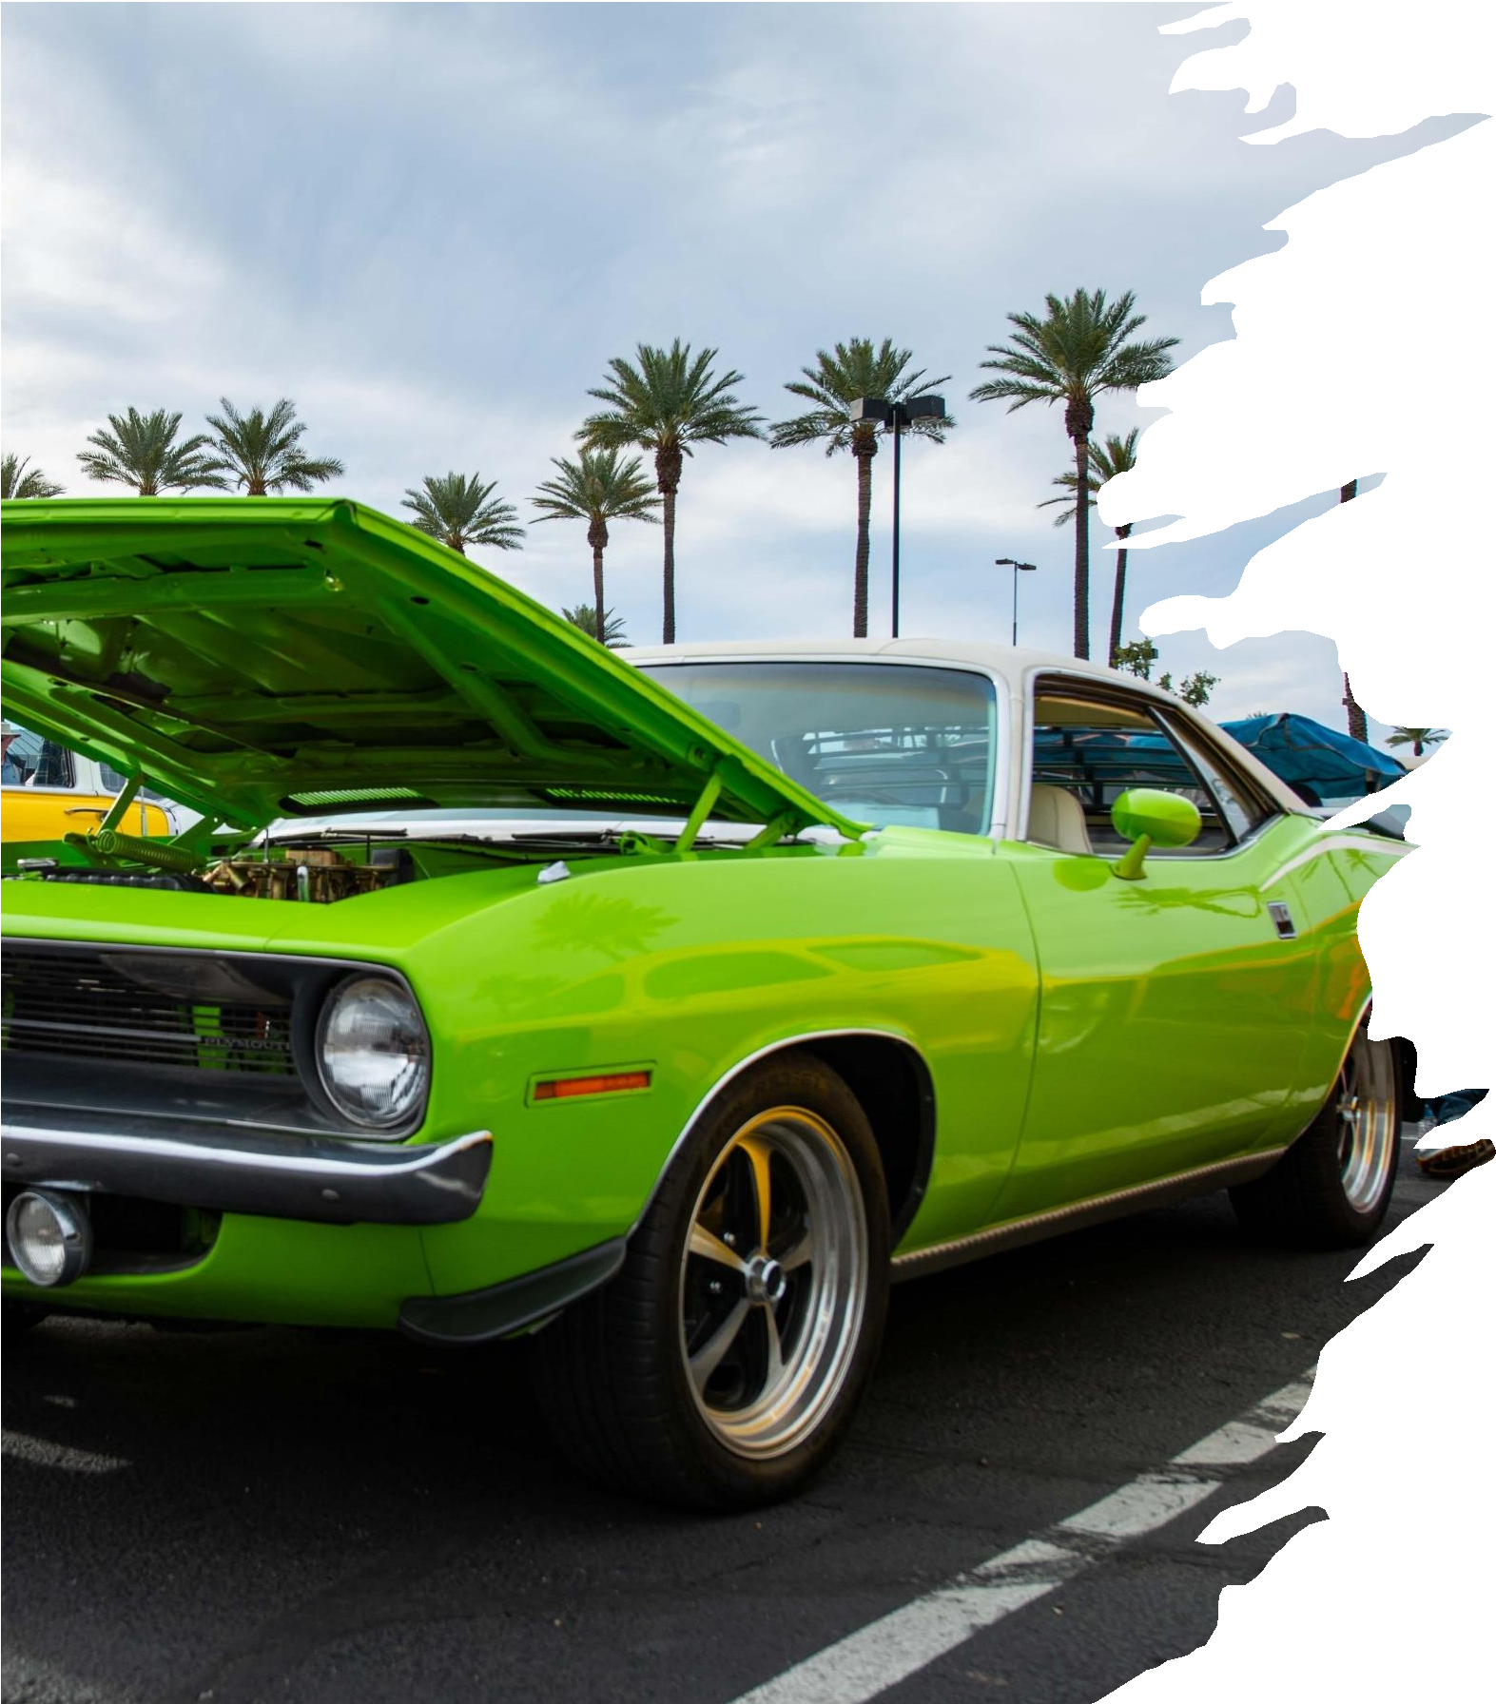
Key Insights
Customer Distribution: The majority of our customers are located in the USA, with Germany following closely.
Popular Product Lines: Among our product lines, "Classic
Cars" stands out as the most frequently ordered, closely followed by "Vintage Cars."
Top-Selling Product: The product that has seen the highest
number of orders from our customers is the "1992 Ferrari 360 Spider Red," with the "1937 Lincoln Berline" as the runner-up.
Total Sales: The Company has achieved a commendable total sales figure of $8.85 million to date.
Paris Office Excellence: Our Paris office stands out in terms of workforce and sales production, surpassing other office locations.
Top-Performing Employee: Gerard Hernandez from our Paris office has demonstrated exceptional promise as our most prolific employee, generating the highest number of orders.

Slide 22

Recommendation
Market Expansion: While the USA is a significant market, consider leveraging the success in Germany as a stepping-stone to further expand into European markets. Invest in marketing and customer engagement strategies specifically tailored to European audiences to tap into this growth potential.
Product Line Expansion: Capitalize on the popularity of "Classic Cars" and "Vintage Cars" by expanding these product lines. Introduce new models, variations, or related accessories to cater to the existing customer interest and potentially attract new customers with similar preferences
Promote Best-selling Products Focus marketing efforts on promoting the "1992 Ferrari 360 Spider Red" and the "1937 Lincoln Berline" as top- selling products to maximize sales and customer engagement.
USA Market Expansion: Prioritize and expand efforts in the USA market due to its significant contribution of 34.38% of total sales, aiming to sustain and potentially increase this market share over time.
Employee Recognition and Development: Implement an employee recognition program to celebrate and reward outstanding performance. This can boost morale and motivate all employees to excel. Offer career development paths and opportunities for growth within the organization to retain top talent and allow them to advance their careers.

Slide 23
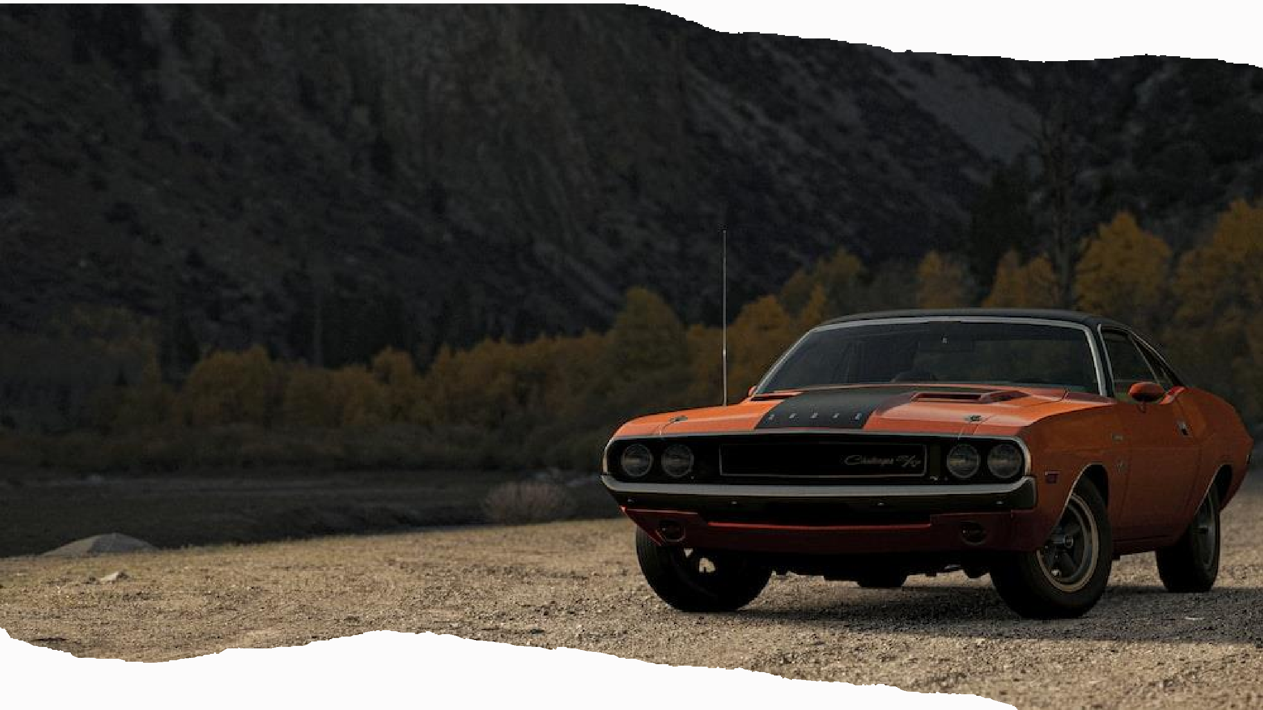
Thank You!
To explore the Interactive Report, visit
[ Sales Report ]
For more About the Project, visit
[ GitHub ]
Author: Abhishek Kumar Shaw

